Slide 1
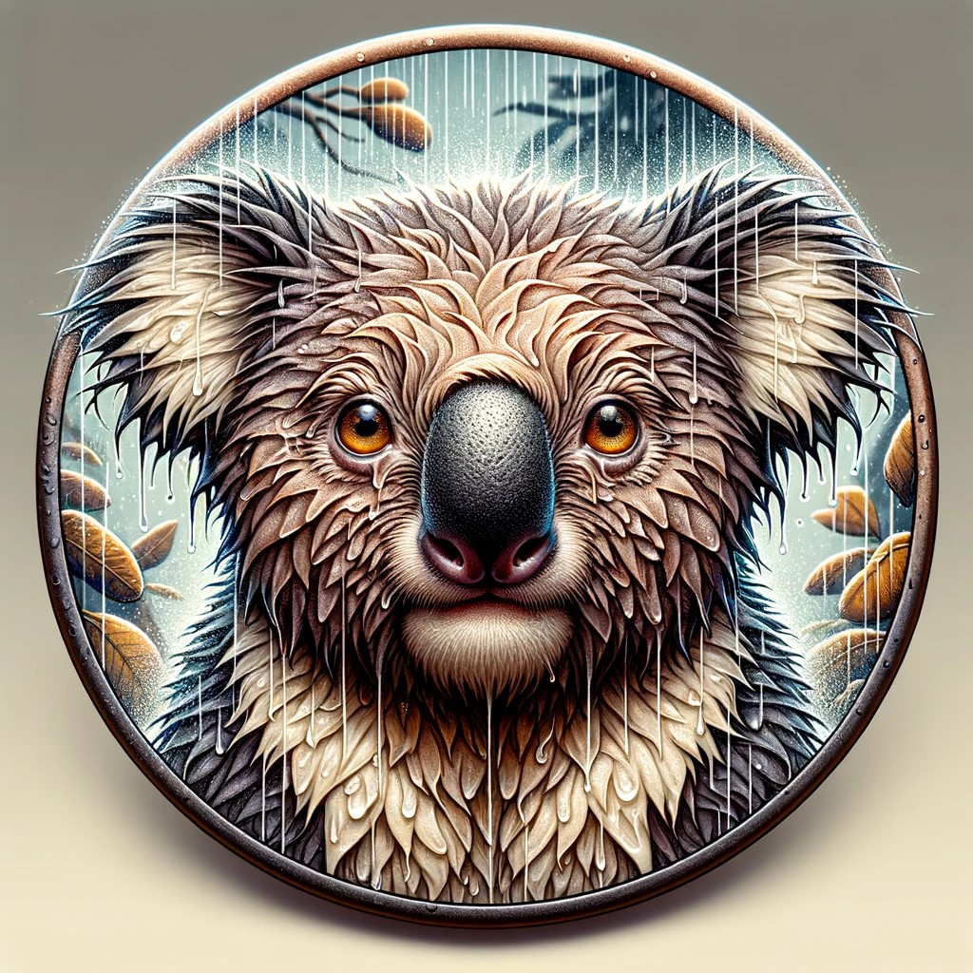
Wet Koalas
Properties
Sad
Many problems with environment and technical stuff at the beginning
No time in the end to implement ideas

Slide 2
Final Model – Ensemble of U-Nets
Ensemble of 3 U-Nets of slightly different design
U-Nets with ResNet34 backbone pretrained on ImageNet
Trained with frozen encoder
Trained with all weights
Trained with less layers
IoU score on test set: 0.166

Slide 3
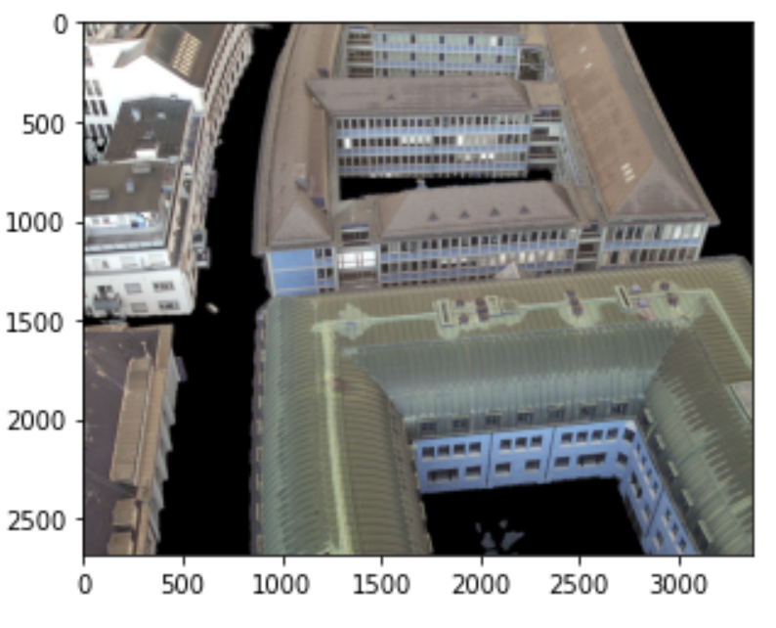
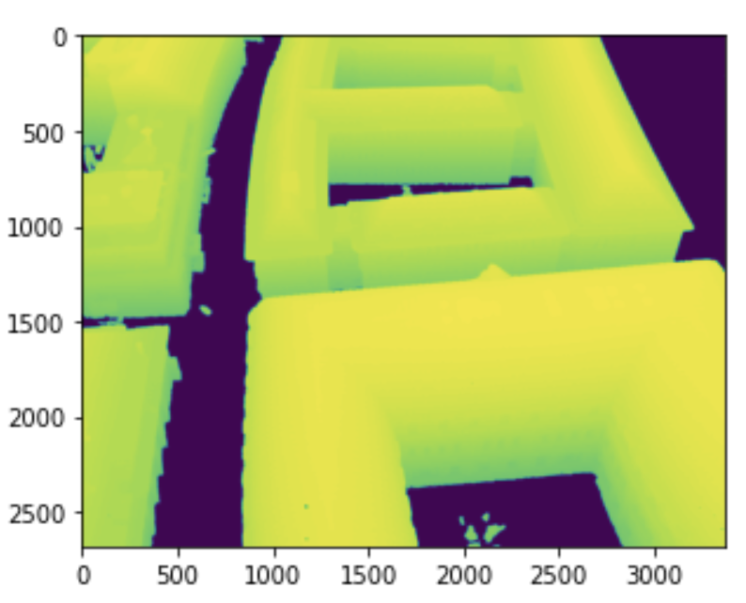
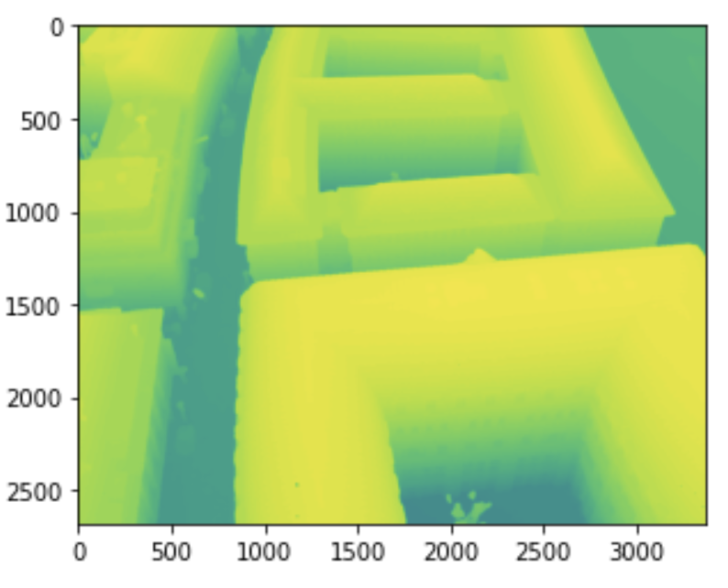
Ideas...
Remove ground level for elimination of false positives
RGB channels corresponding to low depth = 0
And depth data removed from the data

Slide 4
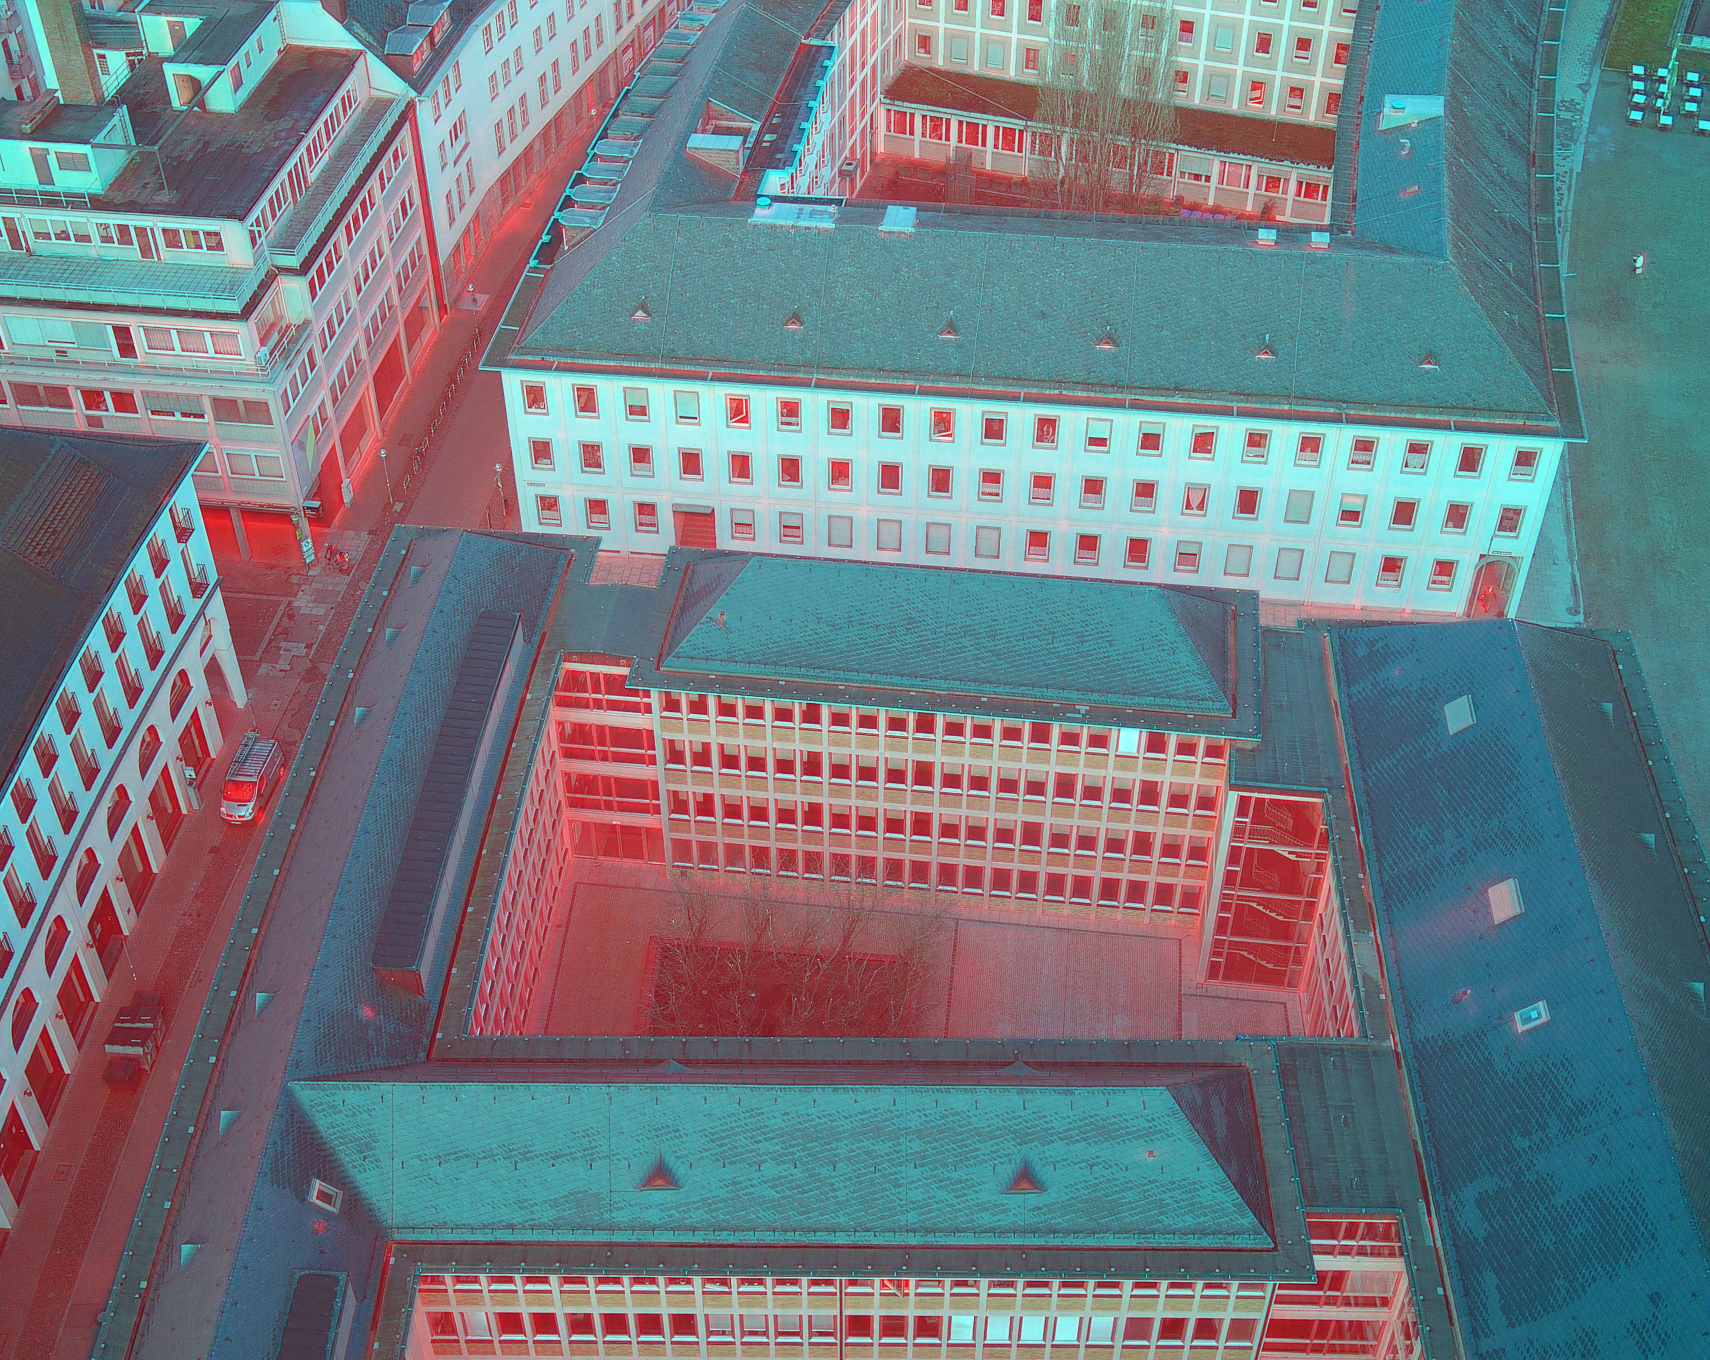
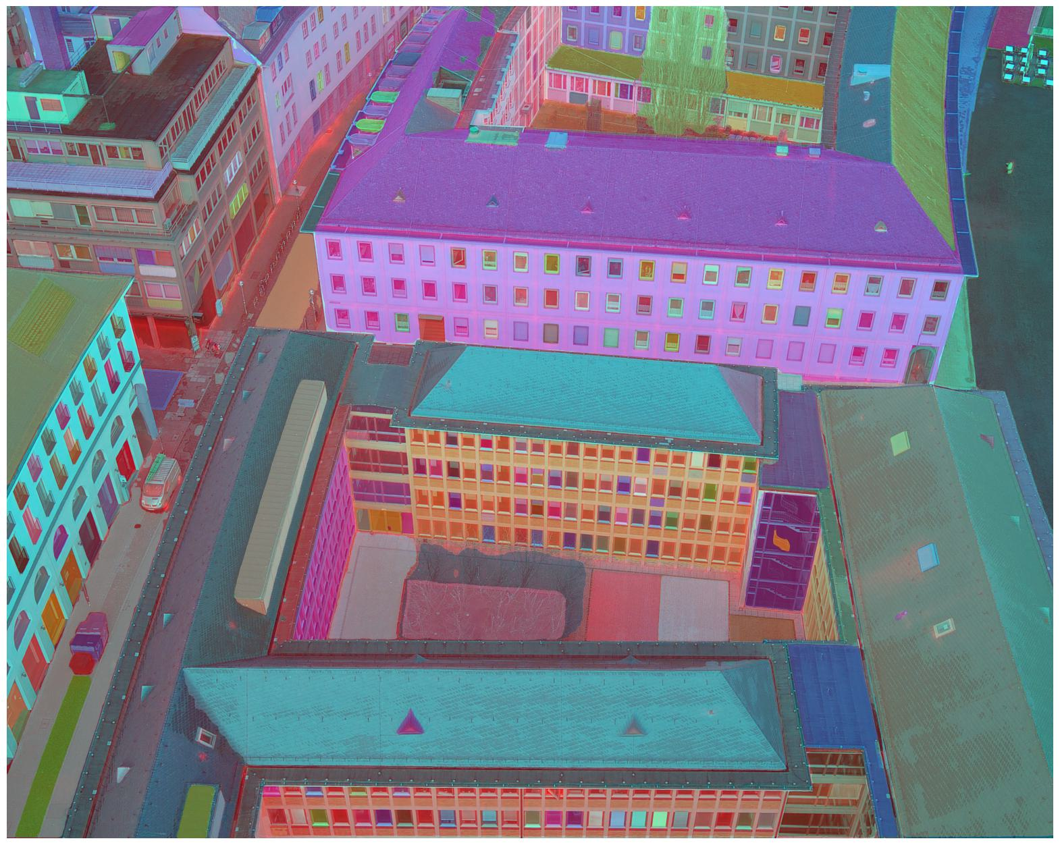
Ideas...
Tried segment-anything implementation
On merged picture of RGB and NIR input
Added a monochromatic mask-channel to input data
Not implemented to ensemble

