Slide 1
HIDA RESEARCH GRANTS
HIDA RESEARCH GRANTS
Teresa Weikert
Susan Trinitz,
Stefanie Gruber-Sliva
Notes:
Logo austauschen!

Slide 2
HIDA Research Grants Info Session
Agenda
The Helmholtz Association of German Research Centers and Helmholtz Information and Data Science Academy (HIDA)
Funding Opportunities: HIDA Research Grants
FAQ

Slide 3
The Helmholtz Association
Research for grand challenges
18 research centers all over Germany and 6 research areas: Energy; Earth and Environment; Health; Information; Matter; Aeronautics and Space
Funding Opportunities: HIDA Research Grants
Germany’s largest scientific organization with 43 000 employees and an annual budget of 5.8 Billion Euros (approx. 6.1 Billion USD)
Notes:
Some examples

Slide 4
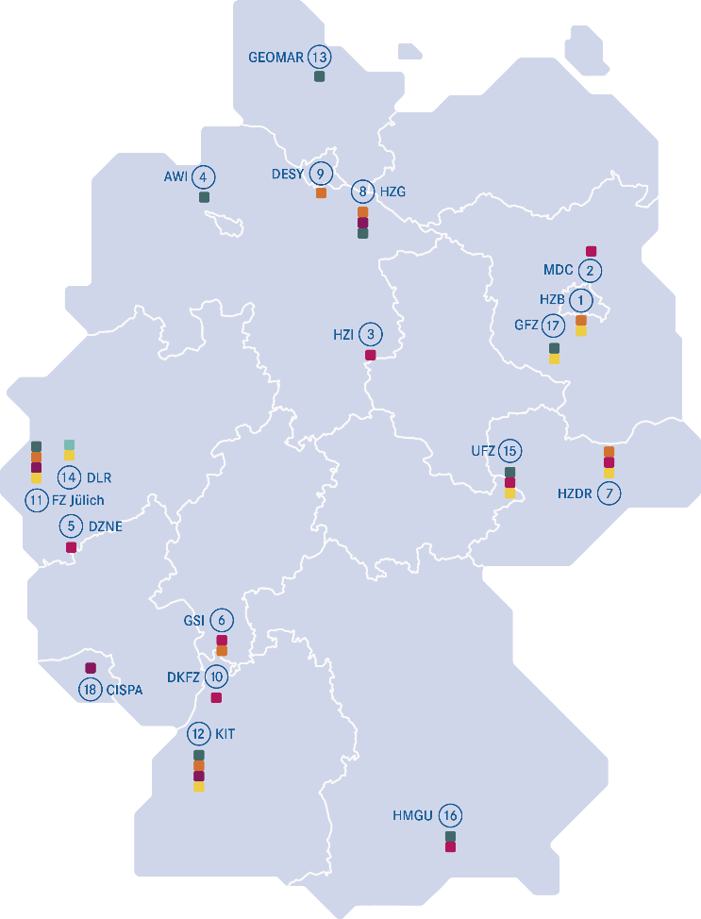
Helmholtz Research Centers
Research Areas:
Energy
Earth and Environment
Health
Aeronautics, Space
and Transport
Matter
Information
1. Berlin Helmholtz-Zentrum Berlin für Materialien und Energie (HZB)
2. Berlin-Buch
Max Delbrück Center for Molecular Medicine in the Helmholtz Association (MDC)
3. Brunswick
Helmholtz Center for Infection Research (HZI)
4. Bremerhaven
Alfred-Wegener-Institut Helmholtz-Zentrum für
Polar- und Meeresforschung (AWI)
5. Bonn
German Center for Neurodegenerative
Diseases (DZNE)
6. Darmstadt
GSI Helmholtz Center for Heavy Ion Research
7. Dresden
Helmholtz Center Dresden Rossendorf (HZDR)
8. Geesthacht
Helmholtz Center Geesthacht
Center for Material and Coastal Research (HZG)
9. Hamburg
Deutsches Elektronen-Synchrotron DESY
10. Heidelberg
German Cancer Research Center (DKFZ)
11. Jülich
Forschungszentrum Jülich (FZ Jülich)
12. Karlsruhe
Karlsruhe Institute of Technology (KIT)
13. Kiel
GEOMAR Helmholtz Center for Ocean Research Kiel
14. Cologne
German Aerospace Center (DLR)
15. Leipzig
Helmholtz Center for Environmental Research – UFZ
16. Munich
Helmholtz Center Munich – German Research Center for Health and the Environment (HMGU)
17. Potsdam
Helmholtz Center Potsdam
German Research Center for Geosciences GFZ
18. Saarbrucken
Helmholtz Center for Information Security – CISPA
Notes:
Germany‘s largest research organization, 18 research centers with different research focusses across Germany (name some centers)

Slide 5
Helmholtz Information & Data Science Incubator
Helmholtz Information & Data Science Academy (HIDA)
HIDA is Germany’s largest postgraduate training network in the field of information and data science
Data Science Events (Conferences, Hackathons, Lectures) & Trainings for researchers of all programs
Over 280 PhD students
6 Data Science Research Schools
Funding Opportunities, exchange programs and networks
Network of 13 research centers and 17 universities
Helmholtz-wide knowledge exchange and transfer of methods
International Network „Friends of HIDA“
Data Science Job Börse & Career Events
Worldwide Employer Branding & Recruiting of High Potentials for all Helmholtz Centers
Notes:
Here: Link to Israel Exchange
https://www.helmholtz-hida.de/en/new-horizons/israel-exchange-program/
Viktoria evtl Vorstellung HIDA (lets discuss)?

Slide 6
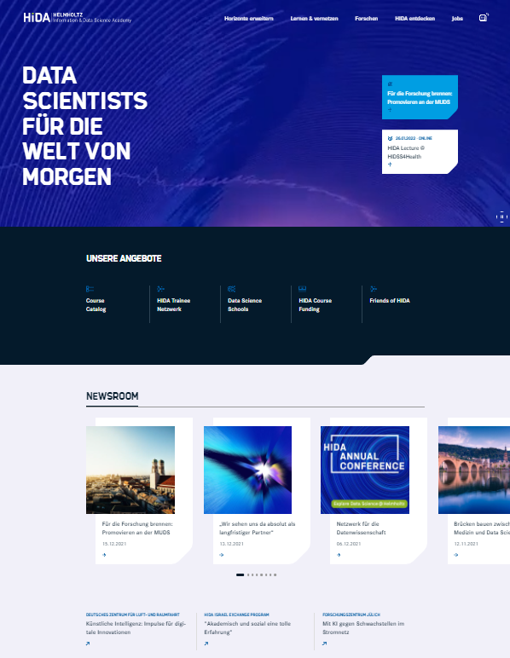
Get in touch with HIDA
Follow HIDA on twitter : @HIDAdigital on LinkedIn
Subscribe to our HIDA Newsletter
Explore our website www.helmholtz-hida.de

Slide 7
Research Grants for Doctoral Students and Postdocs
Helmholtz Visiting Researcher Grant and Trainee Network
Two funding lines:
Trainee Network (for Helmholtz researchers who want to go to another Helmholtz Center)
Helmholtz Visiting Researcher Grant (for researchers from external institutions who want to go to a Helmholtz Center)
Both programs offer self-organized fully funded short-term research stays (for projects with a strong link to data/information science) at one of the 18 Helmholtz centers
Aim: Kick of new collaborations, apply your data science skills and expand your research portfolio
Notes:
Same content, different entryways
Strong Link to data/information science: e.g. if you are biologist by training and want to analyse cell processes with bioinformatics analyses at the host center
Programmes are pretty new still – third application round for the helmholtz-internal programme, just finished the first application round for the Helmholtz Visiting Researcher Grant

Slide 8
Research Grants for Doctoral Students and Postdocs
Which grant should I apply for?
Are you currently a researcher at a Helmholtz Center?
Are you currently a researcher from outside Helmholtz?
Helmholtz Visiting Researcher Grant
HIDA Trainee Network
For eligibility inquiries/if you are unsure what funding line to apply for, please email: hida@helmholtz.de
Notes:
Different funding options for the Trainee Program – I am not going to go into this in too much details here, but please feel free to contact me, should you have questions regarding your situation.

Slide 9
Research Grants for Doctoral Students and Postdocs
Helmholtz Visiting Researcher Grant and Trainee Network
Who can apply?
Doctoral and post-doctoral researchers (in exceptional cases M.A. holders) from inside Helmholtz and from external institutions (universities, research organizations, industry worldwide).
Project needs to have a strong link to the (applied) data and information science
Open to all nationalities from German and from international institutions
Duration: 1 to 3 months
Funding period: Starts (usually) within the 12 months after acceptance (selection process takes approx. 4 to 5 months)
Application Deadline: 15 March and 15 October (every year)
Notes:
Exception for Russia!

Slide 10
Research Grants for Doctoral Students and Postdocs
Helmholtz Visiting Researcher Grant and Trainee Network
Terms of Award
Monthly grant to cover living costs ranging from approx. 2000 – 2800 euros (depending on the funding line, contract status etc.) where applicable with additional allowances for housing, family etc. (Check our website for further information!)
Due to pandemic situation: hybrid formats of research stays are possible (where feasible and if in agreement with applicant and host), planned stays can be postponed in accordance with HIDA
For more information:
https://www.helmholtz-hida.de/en/new-horizons/hida-visiting-program/
https://www.helmholtz-hida.de/en/new-horizons/trainee-network/
Notes:
Any questions so far?

Slide 11
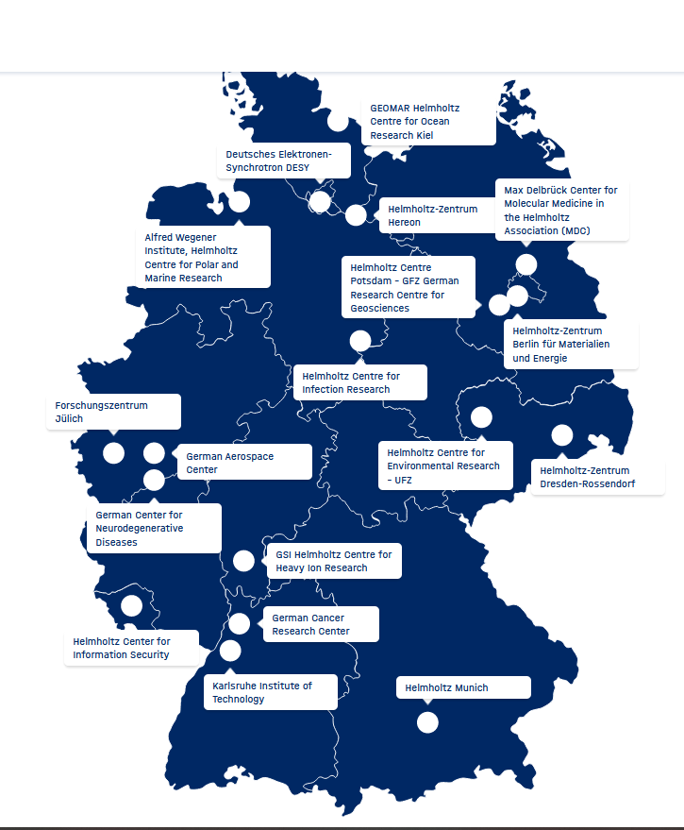
Research Grants for Doctoral Students and Postdocs
Helmholtz Visiting Researcher Grant and Trainee Network
How can I find a host?
Check out the 18 Helmholtz Centers
Ask your supervisor/colleagues
Check out our Database of Helmholtz Hosts
You can contact any Head of Section or Division
at Helmholtz!
For application: Head of Section or Division
(Supervisor during stay: senior scientist/postdoc)
Contact the host directly by email before applying!
https://www.helmholtz-hida.de/en/new-horizons/trainee-network/host-profiles/
Notes:
Lets have a look at the application process – what are the steps…

Slide 12
Research Grants for Doctoral Students and Postdocs
Helmholtz Visiting Researcher Grant and Trainee Network
How do I apply?
Application Portal → Link on HIDA website
How-to-Guide: https://www.helmholtz-hida.de/hida-files/user_upload/pdf_dokumente/GUIDELINES_for_applicants_visiting_202112.pdf
Review process by HIDA Steer Committee and experienced reviewers
Factors: Quality and originality of the research proposal; motivation; benefit for your home group; feasibility; link to information & data science!
Selection procedure in close cooperation and in accordance with the regularities of the involved Helmholtz Centers
https://www.helmholtz-hida.de/en/new-horizons/trainee-network/host-profiles/
Notes:
Lets have a look at the application process – what are the steps…
Application is pretty straightforward and lean …
.Selection procedure in cooperation with the Centers – usually if you fulfill the eligibility criteria, everything should be fine
Any questions?

Slide 13
Thank you for your attention!
Teresa Weikert
teresa.weikert@helmholtz.de

